Slide 1
Final Presentation
11107014
林冠良

Slide 2
Final integration
Send brightness commands to MCU through UART (e.g. Bright 095).
Store the brightness value in EEPROM through I2C.
Retrieve the brightness value from EEPROM automatically each time the program restarts and set the brightness.

Slide 3
Implementation
Final_Integration

Slide 4
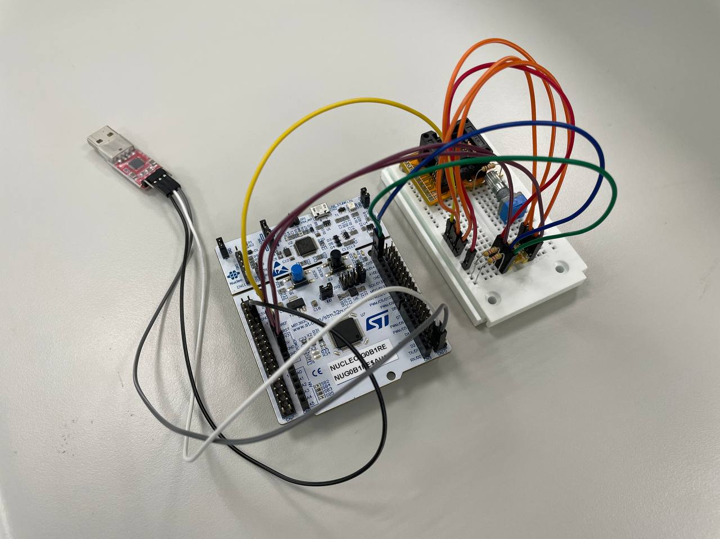
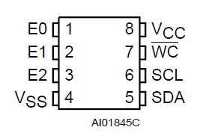
Circuit
E0, E1, E2 and VCC connected to 3V3 in series.
VSS and WC connected to GND.
SCL connected to PB8.
SDA connected to PB9.
UART_RX connected to PC4.
UART_TX connected to PC5.

Slide 5
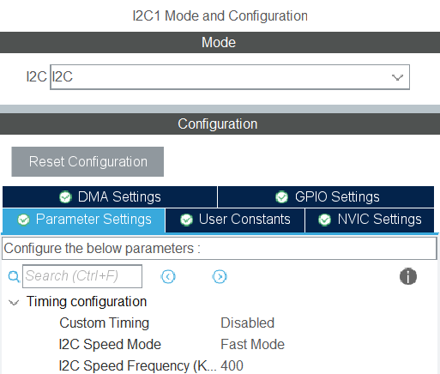
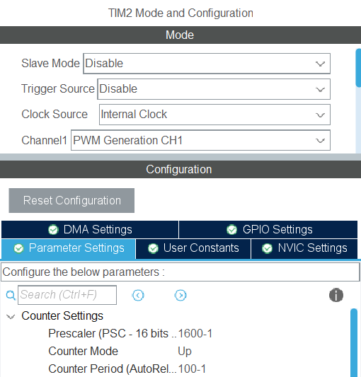
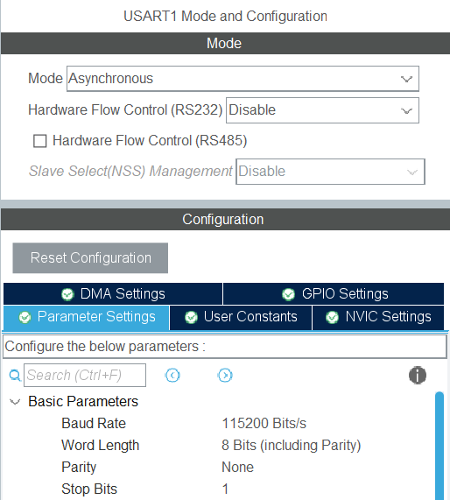
Enable each interface
TIM2
Channel 1: PWM Generation CH1
I2C
Speed Mode: Fast mode
Speed Frequency: 400kHZ
Uart
Mode: Asynchronous
Baud Rate: 115200 bit/s
Enable interrupt in NVIC

Slide 6
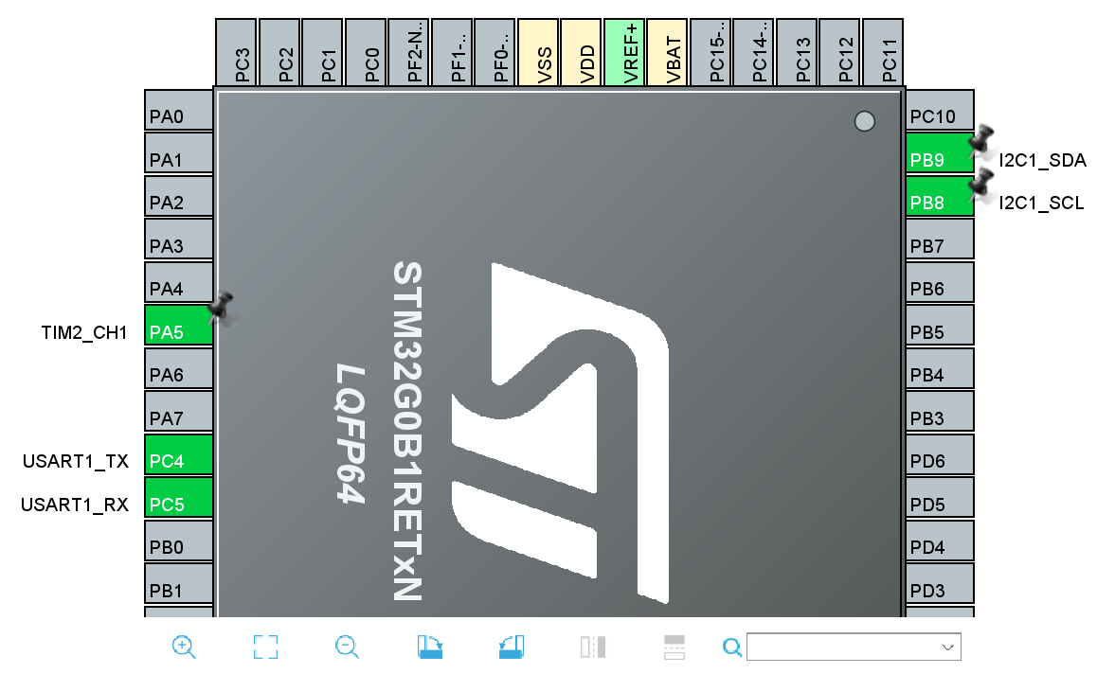
Set the pins
PA5 (LD1)
TIM2_CH1
PC4
USART1_TX
PC5
USART1_RX
PB9
I2C1_SDA
PB8
I2C_SCL

Slide 7
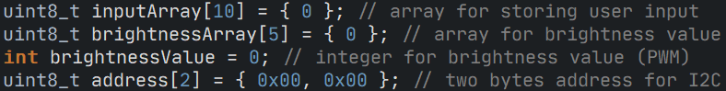
Initialize variables

Slide 8
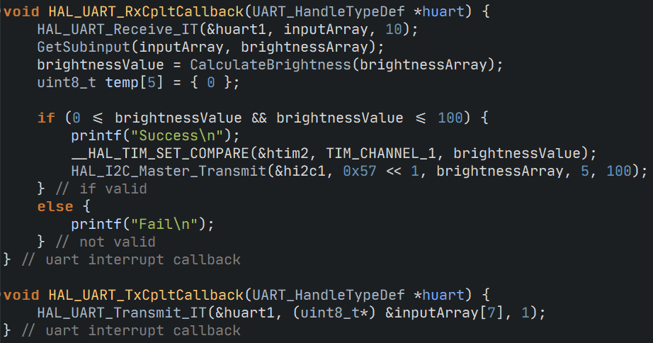
Callback functions for UART

Slide 9
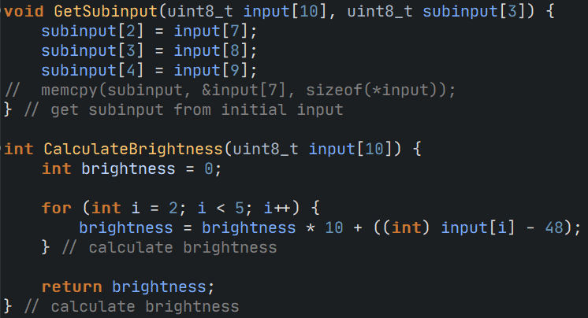
Other custom functions

Slide 10
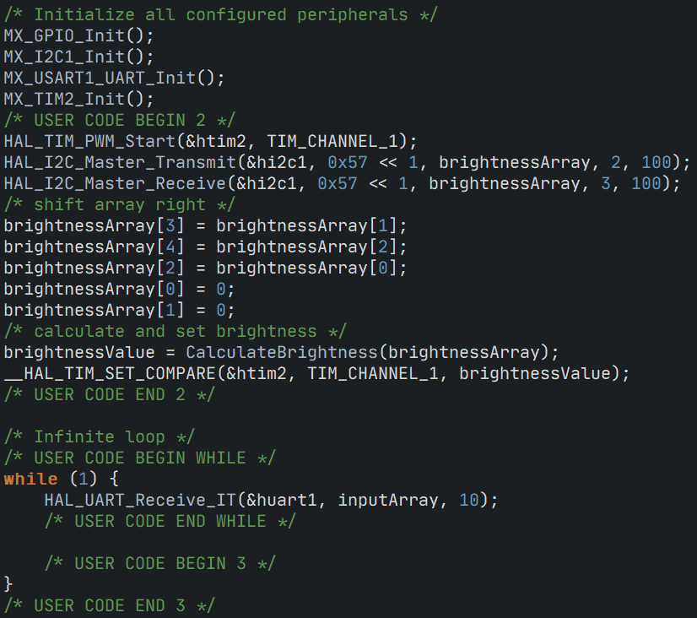
Main

Slide 11
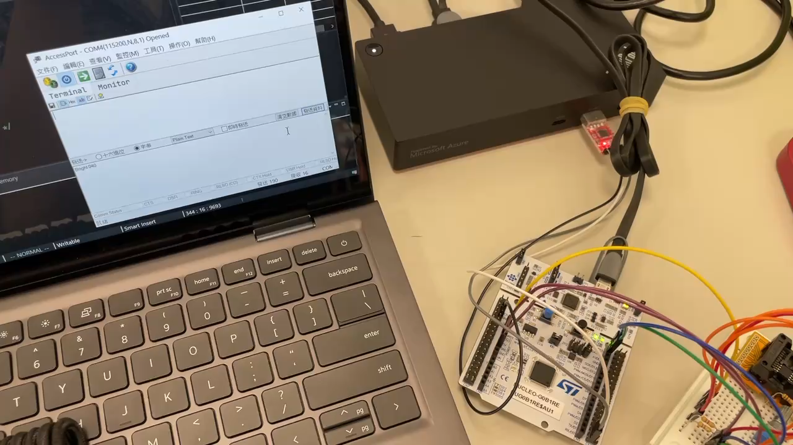
Results

Slide 12

Thank you for your listening
林冠良
Noah_Lin@wistron.com
https://github.com/popshia

Slide 13
Extra
I2C_Simulation

Slide 14
I2C simulation
Simulate I2C signals using GPIO
Write data to EEPROM.
Read data to EEPROM.
Data size should be at least 8 Byte.

Slide 15
Implementation
I2C_Simulation

Slide 16
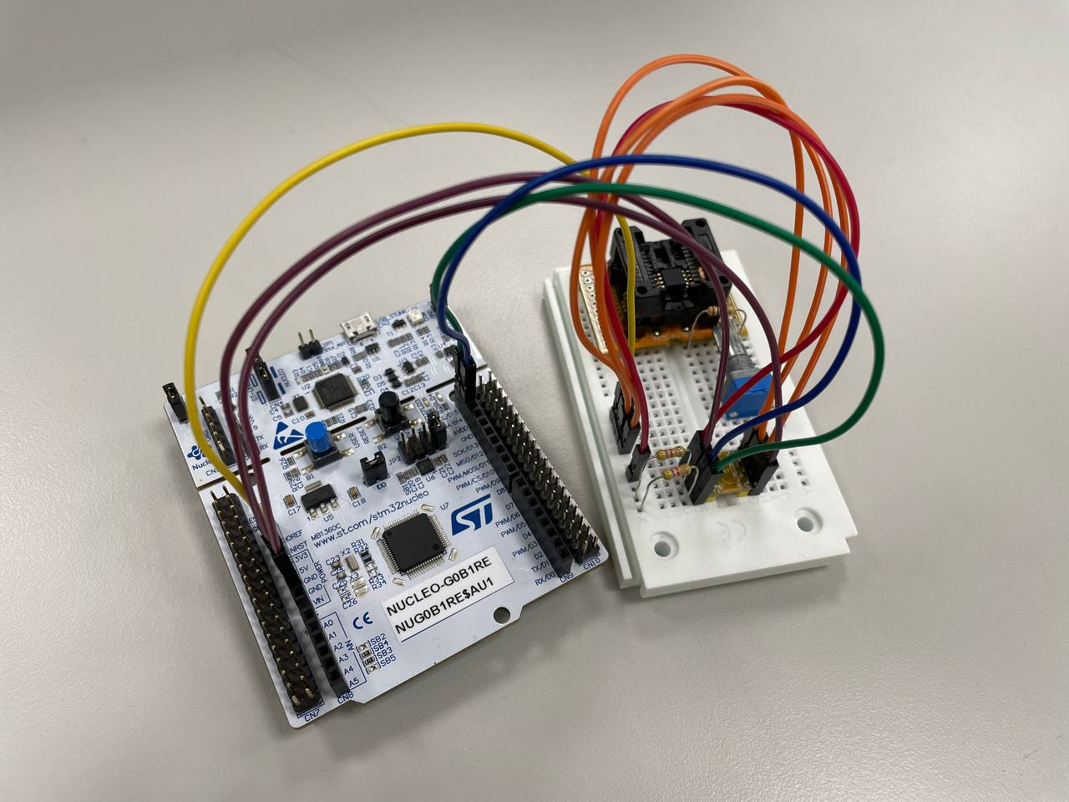
Circuit
E0, E1, E2 and VCC connected to 3V3 in series.
VSS and WC connected to GND.
SCL connected to PB8.
SDA connected to PB9.

Slide 17
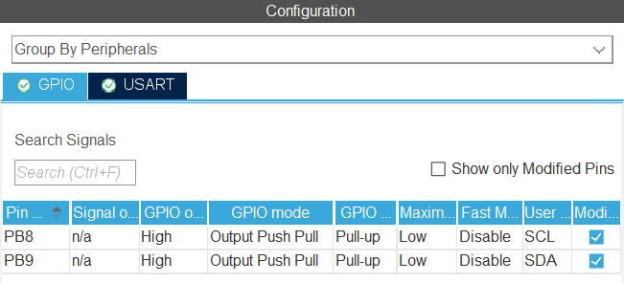
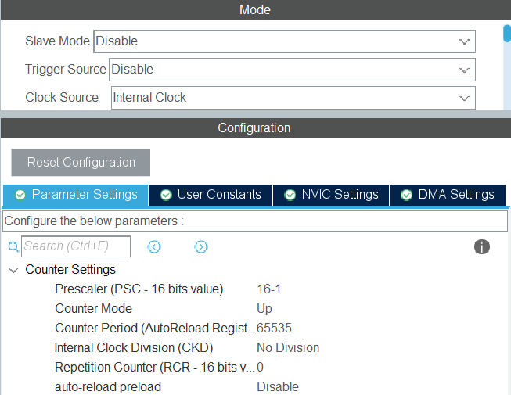
Enable each interface
PB8 (SCL)
GPIO output level: High
GPIO mode: Output Push Pull
PB9 (SDA)
GPIO output level: High
GPIO mode: Output Push Pull
TIM1
Prescaler: 16-1 (1 tick per us)

Slide 18
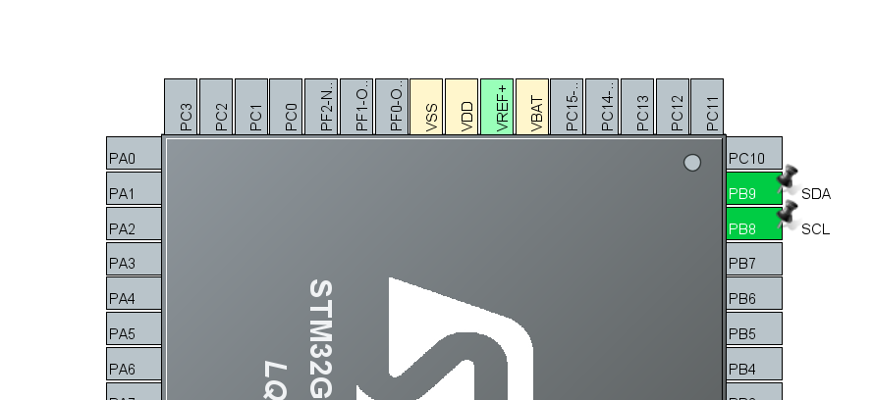
Set the pins
PB9
GPIO_Output
PB8
GPIO_Output

Slide 19
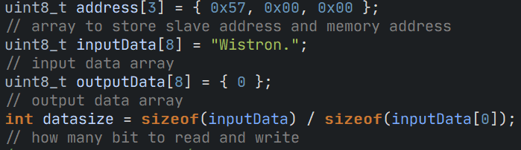
Initialize variables

Slide 20
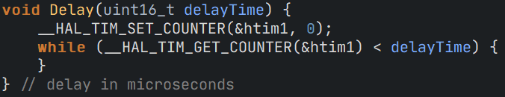
Delay (using Timer)

Slide 21
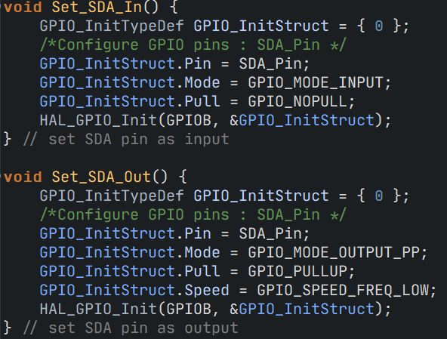
Set SDA Directions

Slide 22
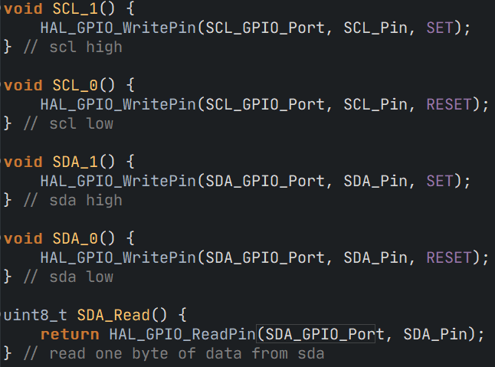
Set SCL/SDA and Read SDA pin

Slide 23
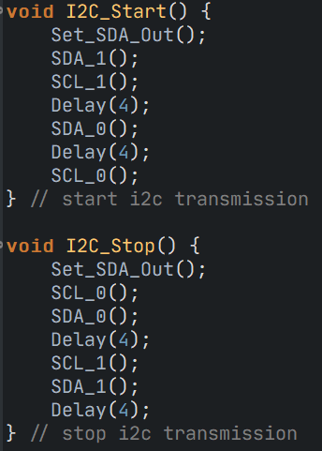
I2C Start/Stop Routine

Slide 24
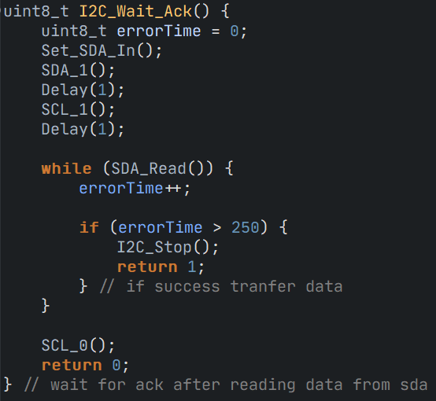
Wait ACK

Slide 25
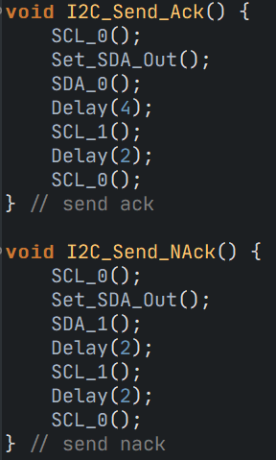
Send ACK/NACK

Slide 26
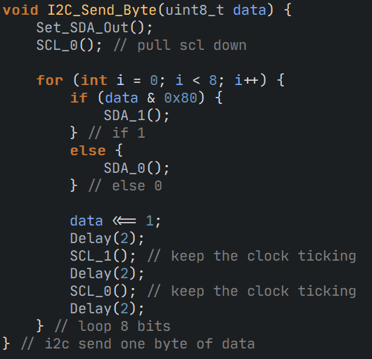
Send a byte of data

Slide 27
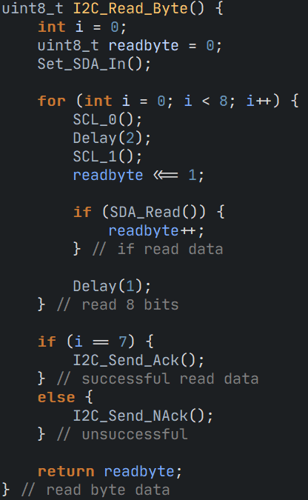
Read a byte of data

Slide 28
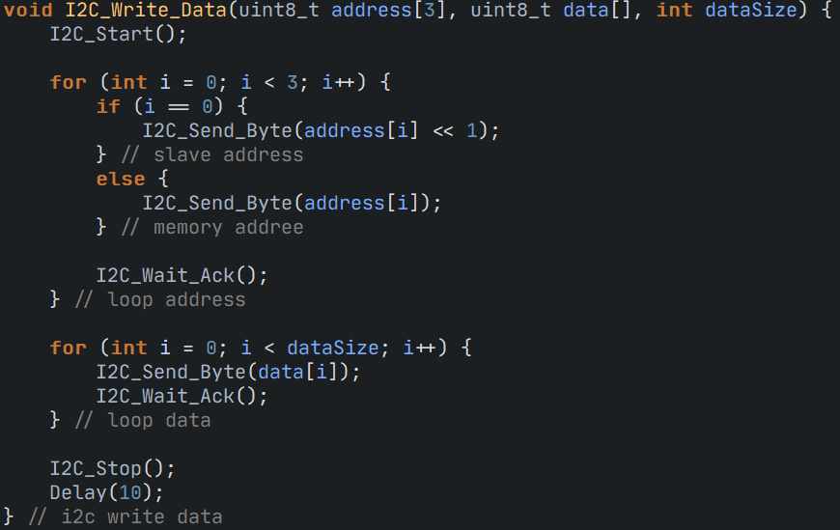
Write an array of data through I2C

Slide 29
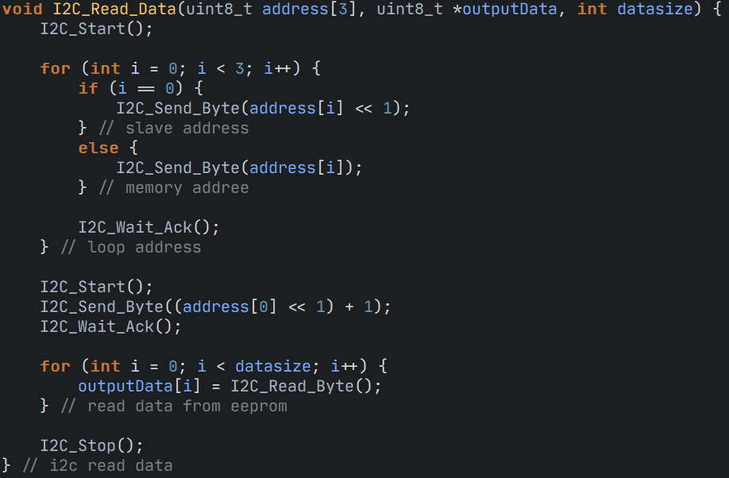
Read an array of data from I2C

Slide 30
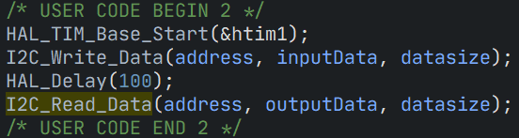
Main

Slide 31
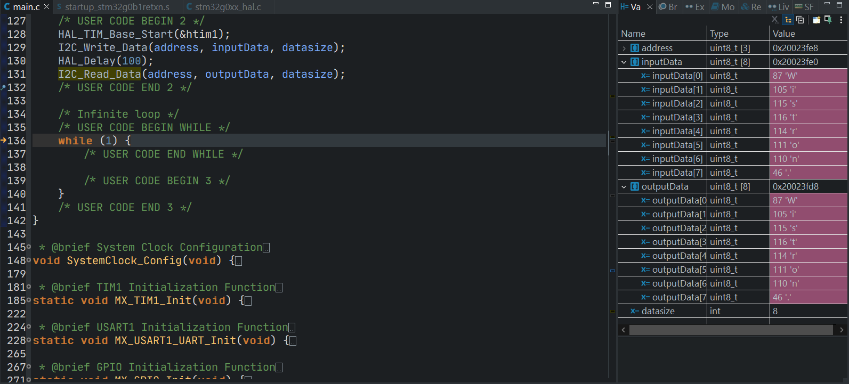
Result

